Slide 1
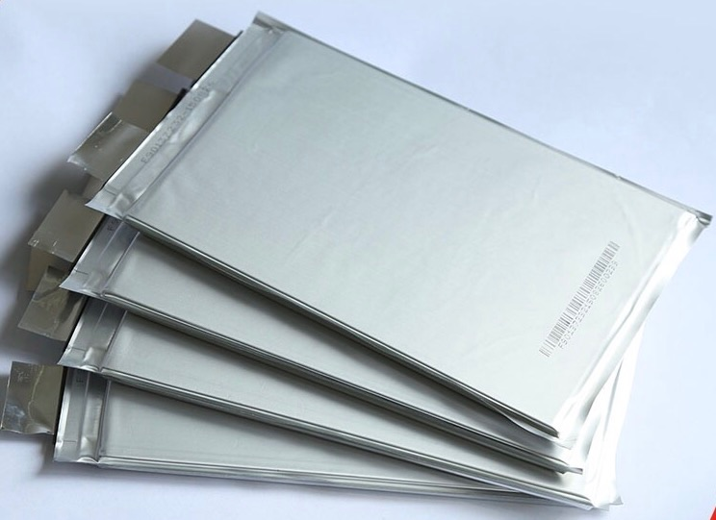
Lithium-Ion Batteries
Electrochemical energy storage devices
Secondary battery
Social awareness
Climate changes due to the CO₂ emissions
Electric vehicles (EVs)
Energy storage for solar energy

Slide 2
Challenges
Raw materials
Overall production cost
High production ,huge waste
Global LIBs recycling market 1,11,783 t in 2018
Expected to reach approximately 6,41,595 t in 2025
less than 5% is recycled

Slide 3
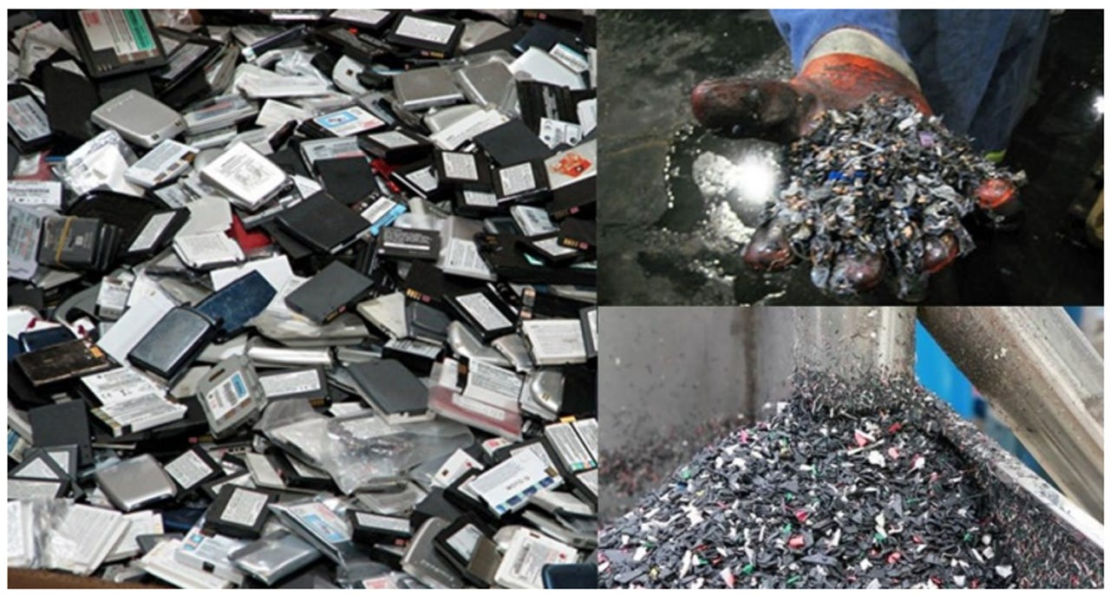
How Can We Manage LIBs Waste
Second life use
For house hold works or backup system.
Buried in land
Damage to soil, explosive
Burned
Produce poisonous gases.
Recycle in closed loop process
recover the metals like Co, Ni, Li, etc.

Slide 4
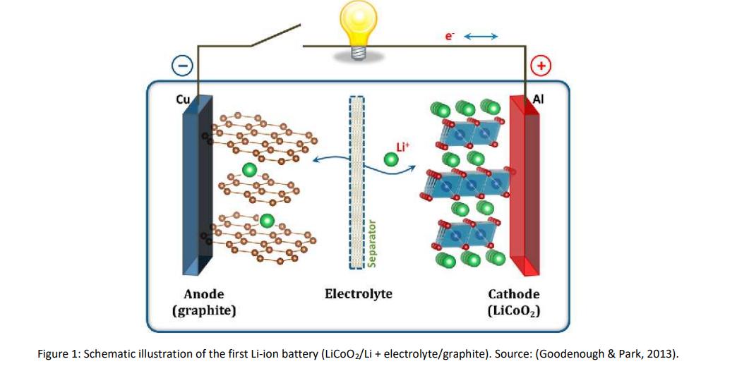

Slide 5
Battery Component | % w/w | Used Material
Case | 25% | Steel/plastics
Cathode | 27% | LiNi_{x}Mn_{y}Co₂O₂
Anode | 17% | Graphite
Current Collectors | 13% | Cu and Al
Electrolyte | 10% | LiPF₆
Separator | 4% | Microporous Polypropylene
Binder | 4% | Polyvinylidene Difluoride

Slide 6
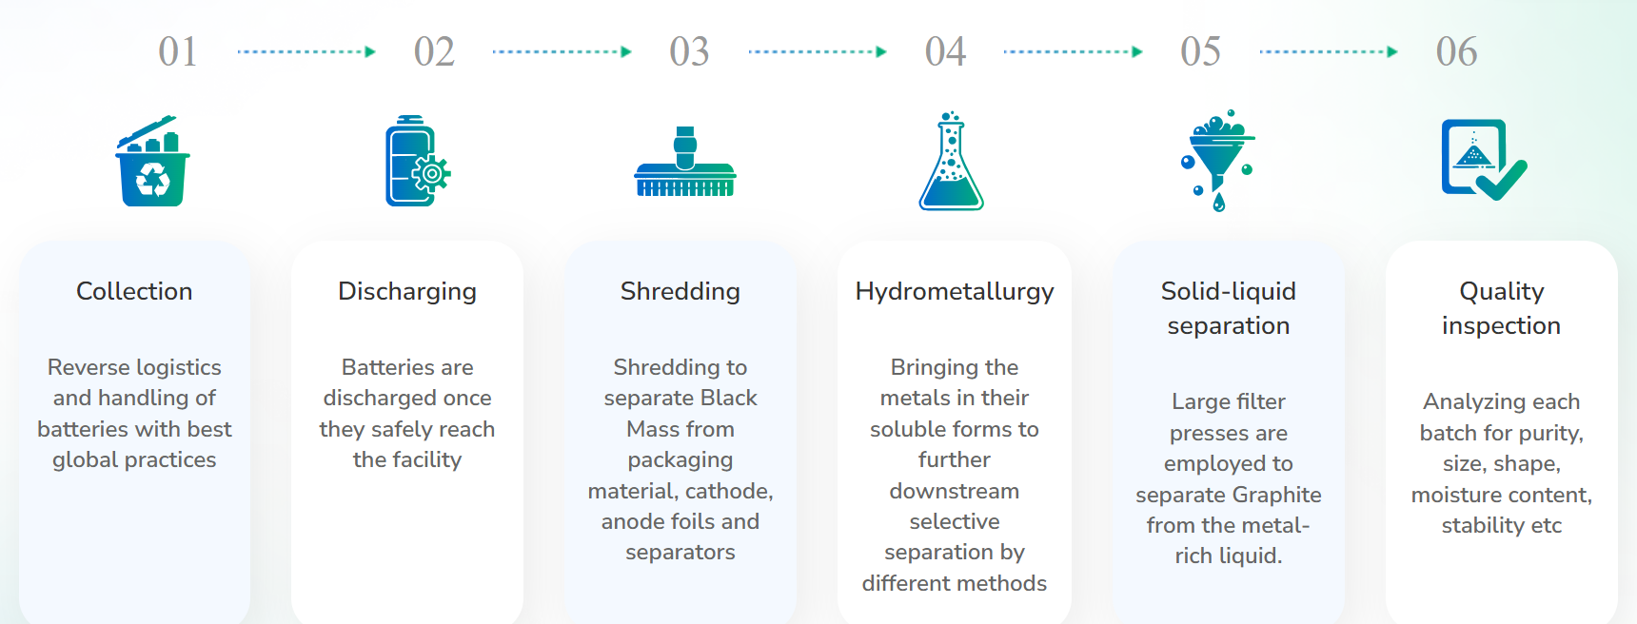
Process For Recycling of Lithium Ion Batteries

Slide 7
Black Mass Producing Unit
(shredding plant)
Feed
Lithium ion battery (pouch cell) ( let 100 kg)
Product
Black mass (cathode and anode material) (55.15 kg)
Al, Cu and separator (38.86 kg)
Electrolyte and waste (11.35 kg)

Slide 8
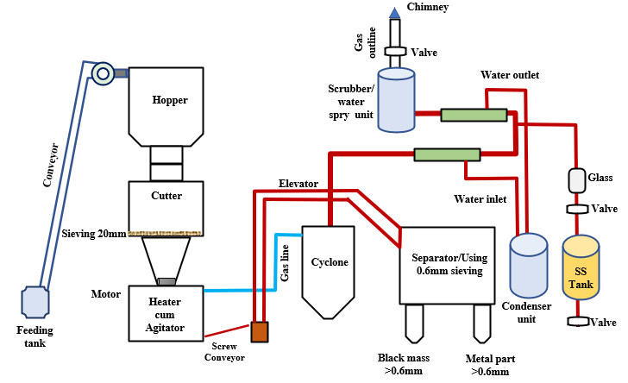

Slide 9
PLANT PROCESSES
Discharge the batteries
NaCl solution OR electrical load
Cutter
Slowest step therefore rate determination step
Heating and Mixer Tank
Fumes of electrolyte, binder loss it properties and black mass separate
Sieving machine
Separate Al and Cu from black mass (mesh size 0.6mm)

Slide 10
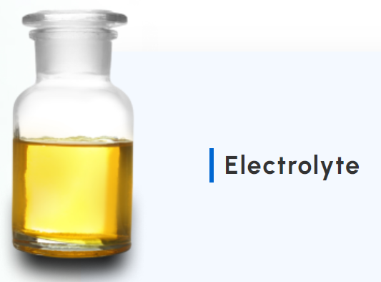
Electrostatic separator
Separate Cu and Al
Cyclone separator
Separate solid particle (black mass) from air (electrolyte fumes)
Condenser unit
Condense electrolyte fumes
Scrubber
Dry scrubber using HEPA or Carbon filters.

Slide 11
Metal Extraction Unit
Metal extraction (hydrometallurgical methods)
FEED
Black mass
PRODUCT
Graphene
Cobalt sulfate
Copper sulfate
Nickel sulfate

Slide 12
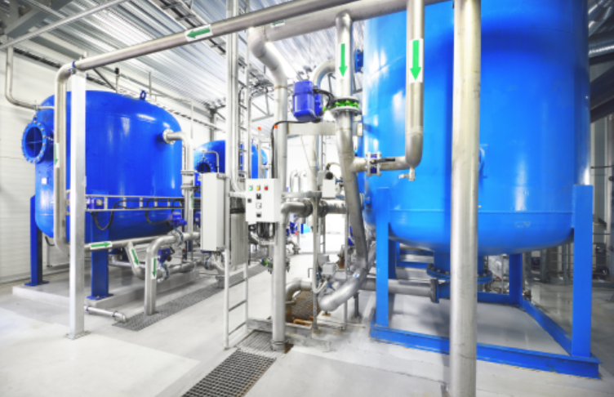
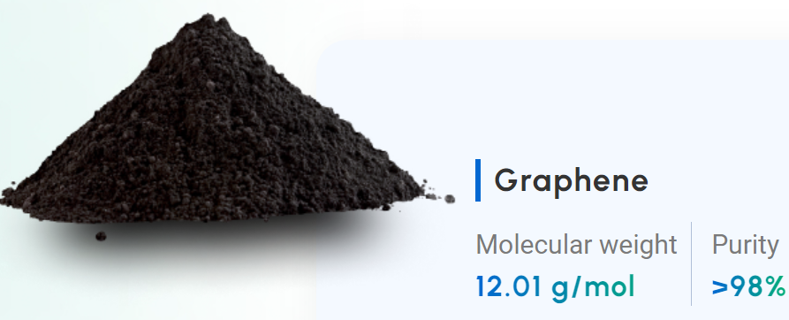
REACTOR 1
Working capacity = 100liters (let)
Inlet = water H₂SO₄ Black mass
Time 2 hrs.
FILTERATION UNIT
Filtration Press
Inlet leached residue
extract graphene(mesh size 25 micron)

Slide 13
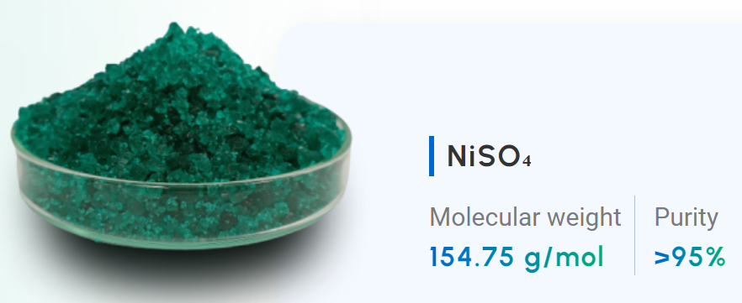
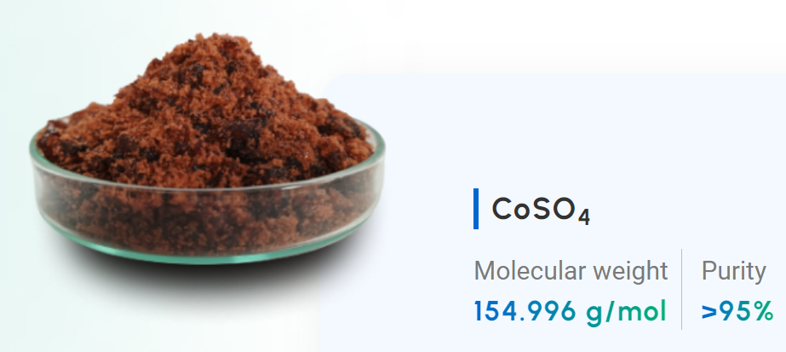
REACTOR 2
Inlet = leach liquor + H₂SO₄
Outlet = Selective Extraction(stripping) of NiSO₄ and
CuSO₄
REACTOR 3
Inlet = leached liquor
Outlet = CoSO₄ (ppt)

Slide 14
FUTURE SCOPE
Increase purity level (Electrolysis)
Make continuous process
Find application of derived material
for ex Graphene - graphene oxide - supercapacitor and anticorrosion.

Slide 15
THANK YOU

